Slide 1
Engineering Graduate Salary Prediction
Akhil D.U
(IL022340)
PGA-20

Slide 2
Problem Statement:
Engineering Graduates in India: India has a total 6,214 Engineering and Technology Institutions in which around 2.9 million students are enrolled. Every year on an average 1.5 million students get their degree in engineering, but due to lack of skill required to perform technical jobs less than 20 percent get employment in their core domain.
To determine the salary and the jobs these engineers are offered right after graduation. Various factors such as college grades, candidate skills, the proximity of the college to industrial hubs, the specialization one have, market conditions for specific industries determine this. Based on these various factors,
“The objective is to determine the salary of an engineering graduate in India.”

Slide 3
Business Use:
The model will help to predict The Salary of An Indian Engineering Graduate
Through various EDA analysis done, it allows to understand what influences the salary and job titles in the labor market.

Slide 4
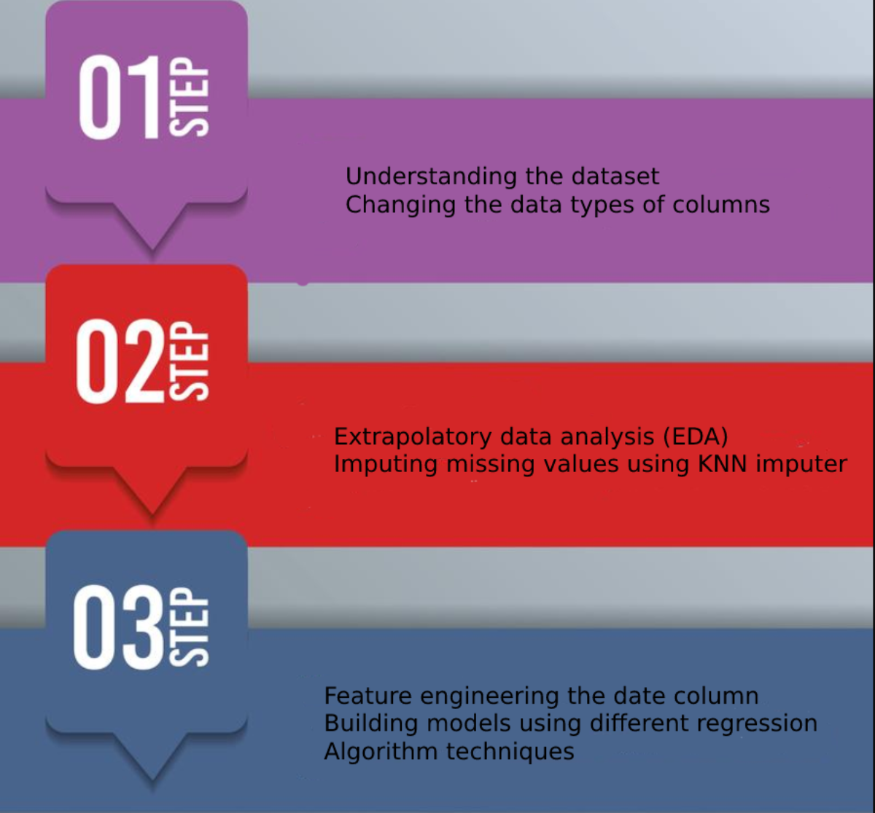
Approach:
Note :
RMSE & MAPE value has been used to Evaluate the best model.
MAPE <10% for a model is considered as good model to be able to make accurate prediction.
Hence the model with least MAPE value closer to “0” will be selected as the best model.

Slide 5
Findings and the methods used:
Data was understood by performing various extrapolatory data analysis on the dataset for both Continuous and Categorical Features.
Few Columns in the data frame had an invalid value as “-1”, therefore converted them to null values and performed imputation using KNN imputer
“Specialization” & “CollegeState” variables had too many categories in them resulting in High Cardinality. Hence, reduced by grouping the categories based on logic.
Outliers were present for all the columns, performed the Outlier analysis via IQR method
Data engineering was done on the “DOB” column to extract features like `year`, `quarter`, `weekofyear`, `month`, `day`, `hour`, `minute`. further converted the Column as Age variable by subtracting the values with current year
Due to presence of Outliers, Performed Feature Scaling for all the numerical variables through Standardization
Through the VIF checks, No multicollinearity exists for any of the columns and each variable was independent to each other

Slide 6
Different Regression models were tried out such as Linear Regression both SGD & CFS, Decision Tree, Random forest & Random forest using best parameters, Boosting algorithms like Adaboost, GradientBoosting & XGBoost.
Based on comparing the Evaluation metrics (RMSE & MAPE), Model built using “Random Forest” technique provided Least error compared to all other techniques.

Slide 7
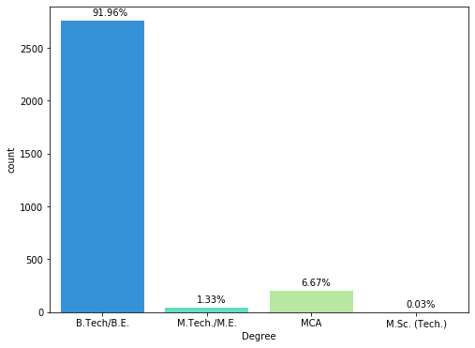
Course Enrolled by students
Majority of the students almost 91.96% are B.Tech/B.E graduates by this we can conclude that most students in India have B.Tech as their Highest Education

Slide 8
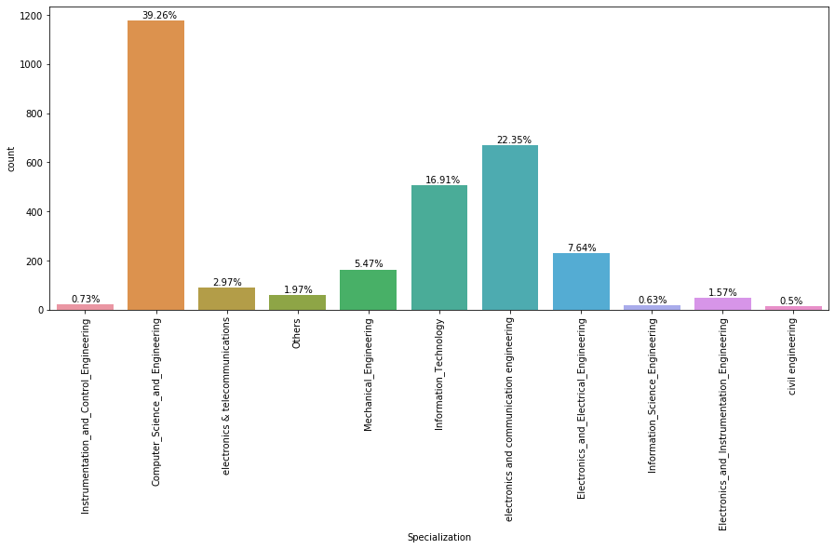
Core Specializations students consider for graduation
Majority of the students have been enrolled in “Computer Science & Engineering” specialization or Computer related course like programming, networking, etc.
Electronics & communications is next specialization after CSE, to which most of the students choose as their specialization.

Slide 9
Further improvements:
Feature selection techniques such as forward elimination, backward elimination and RFE method can be used to select features for further improvements.

Slide 10
Result:
4
Out of all the models built using different Regression Techniques, Random Forest algorithm using feature selection technique yielded the best Evaluation result compared to other models.
RMSE: 36030.17448662575
MAPE: 3.749811842532091

